Slide 1
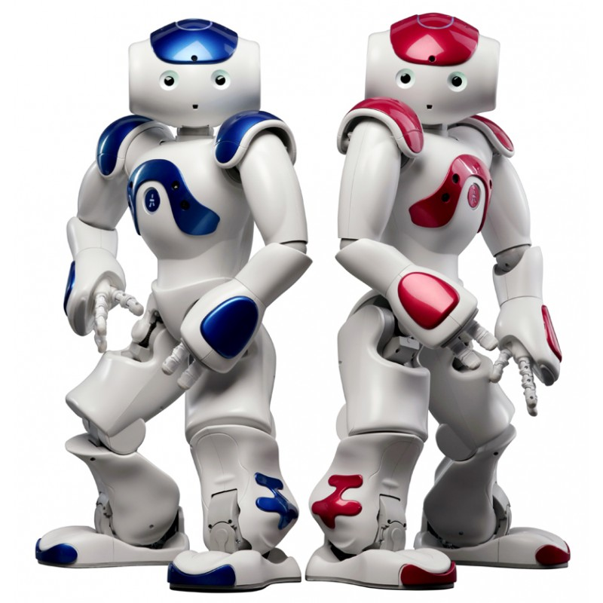
Improving Human Computer Interaction with Machine Emotional Intelligence using NAO Robot.
Manas Kale – 403037
Rohit Patankar – 403053
Shubham Punekar – 403061
Saurabh Shirodkar - 403074

Slide 2
About the project
Knowing the emotional state of an individual can be crucial in determining what action is to be taken as a response.
Major focus of the project is improving human-machine interaction using the NAO robot. The robot will accept the input from the person periodically in the form of speech samples, comprising of voice and text as well as facial cues and will interpret the current emotional state of the person.
The robot will not be able to detect every single complex emotion, but will be limited to a subset of generalized emotions.
According to the detected emotion, NAO robot will give an appropriate response. The response will be a combination of vocal response as well as physical gestures. This humane response will make the robot an ideal companion for old people.

Slide 3
Solution Design

Slide 4
Applications and future scope
Primary aim is humanizing the NAO robot to make it an ideal companion for old people
There are myriad of other uses that can be achieved :
Development of an affect-aware city
Add security layer at public venues to detect malicious intent and deal with hostage situation effectively
Measure response and ratings in focus groups (consumer response to commercials etc.)
Wearables that help autistics discern emotion etc.

